Slide 1
PROJECT TITLE
AD5302 – DATA SCIENCE
ACCESSIBILITY NAVIGATION APP
Presenting By
Team Member 1 Name : Deebiga S
Team Member 1 Regd No. : 210425243046
Team Member 1 Section : A
Team Member 2 Name : Geerthanyaa G
Team Member 2 Regd No. : 210425243067
Team Member 2 Section : A

Slide 2
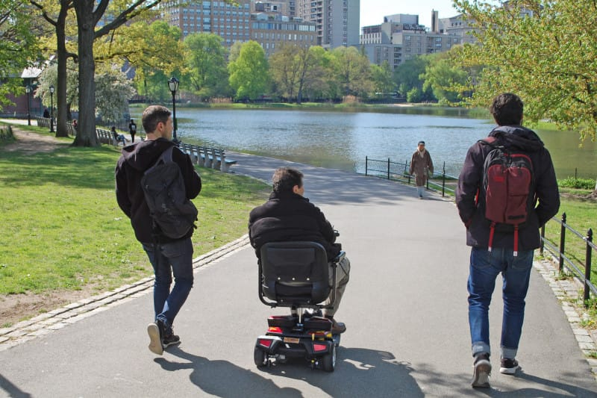
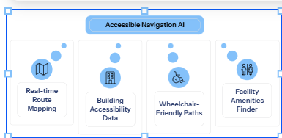
Problem Identification and Title Justification
Navigate Without Barriers

Slide 3

Problem Identification and Title Justification
🚧 No Ramp Info
Apps don't indicate whether a building has a wheelchair ramp at its entrance.
🛗 No Elevator Data
Elevator availability is never factored into routing
🪜 Hidden Stairs
Stairs blocking pathways appear only upon arrival
🛣️ Unknown Sidewalks
Sidewalk accessibility and surface quality are ignored

Slide 4
Literature Survey
Research Foundations
Accessible Route Planning
Kamiya et al. (2020) — wheelchair routing using OpenStreetMap accessibility tags.
Crowd-Sourced Accessibility Data
Al-Khalifa (2019) — participatory mapping for urban accessibility via mobile apps.
AI for Disability Navigation
Shoval et al. (2018) — ML models predicting path accessibility for mobility-impaired users.
Universal Design in Navigation
Steinfeld & Maisel (2012) — universal design principles applied to wayfinding systems.

Slide 5
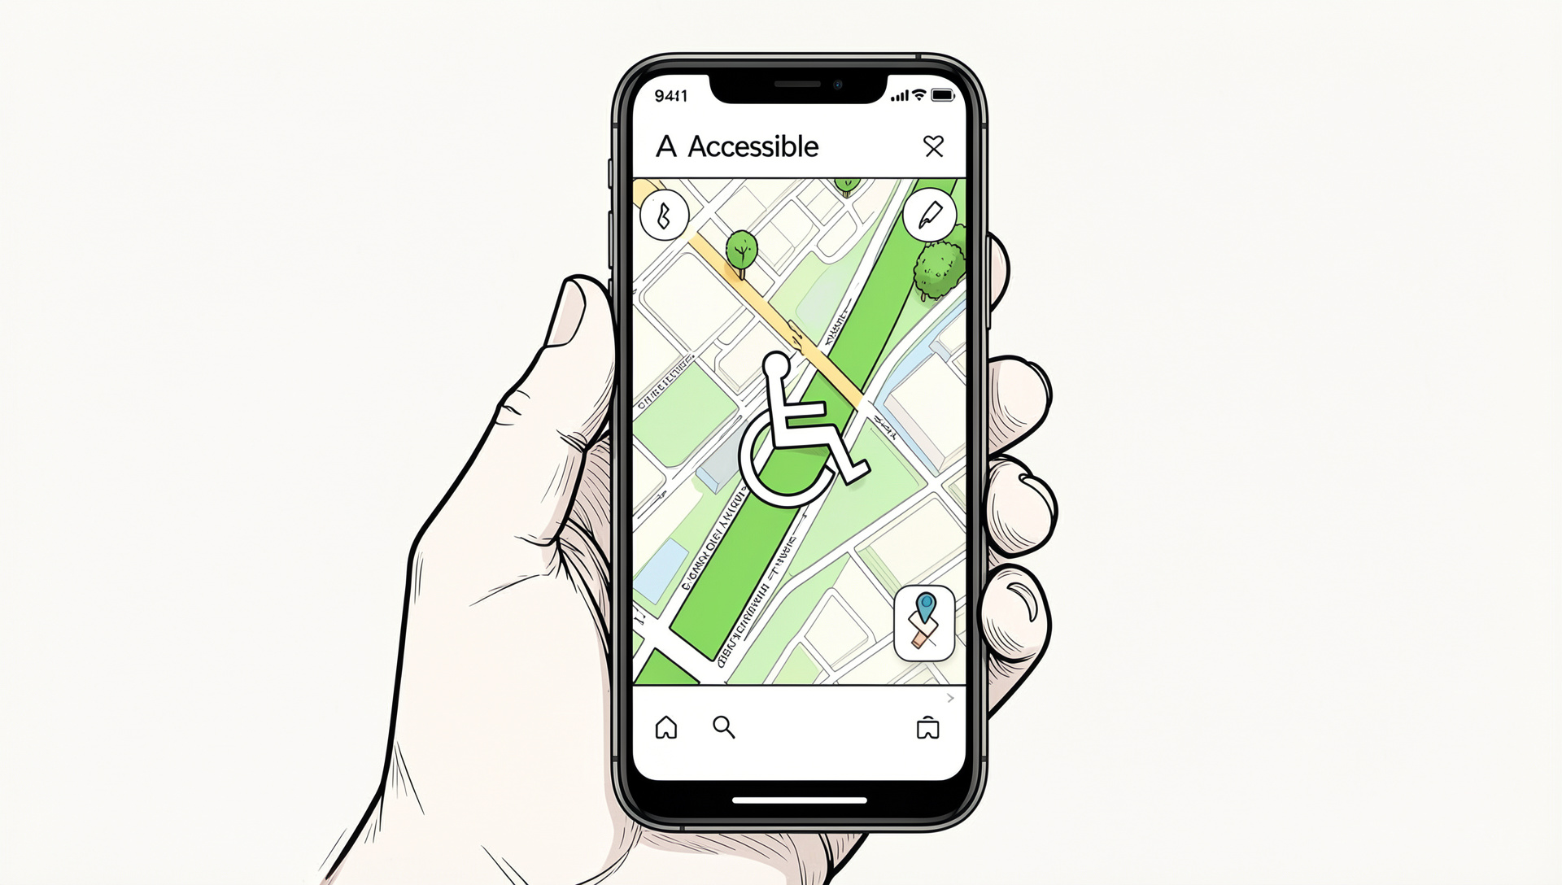
Objectives of the Project
AI-powered navigation system
Wheelchair-friendly routes
Accessible building discovery
Location accessibility ratings

Slide 6
Project Planning and Time Schedule
Phase 1 ·
Phase 2 ·
Phase 3 ·
Research, requirements gathering, and UI/UX wireframes.
Core app development: route finder, map integration, and accessibility database.
Beta launch, user testing with mobility-impaired participants, and iteration.

Slide 7
References
Academic & Industry Sources
1.Wheelmap.org — Crowd-sourced wheelchair accessibility mapping (2010)
2.Access Earth App — Venue accessibility reviews (2015)
3.Google Project Guideline — AI navigation for visual impairment (2021)
4.Microsoft Accessibility Insights — Automated compliance auditing (2022)
5.WHO Global Report on Disability (2023)
Technical Foundations
OpenStreetMap — Open-source geographic data
TensorFlow / PyTorch — Accessibility scoring models
Google Maps Accessibility API — Route data integration
W3C WCAG 2.1 — Digital accessibility guidelines
ADA Standards for Accessible Design — Physical infrastructure compliance

Slide 8
Thank You!

